Slide 1


Object-Oriented Programming in PHP
Classes, Objects, Interfaces, Inheritance, Polymorphism
Mario Peshev
Technical Trainer
http://peshev.net
Software University
http://softuni.bg

Slide 2

Table of Contents
Classes and Objects
Methods and Properties
Scope
Inheritance
Static Methods and Properties
Constants
Abstraction and Interfaces

Slide 3
Table of Contents
Overloading
Object Iteration
Object Cloning
Serialization
Namespaces
Autoloading Classes

Slide 4

Classes And Objects

Slide 5
Object Oriented Programming
The idea of Object Oriented Programming is to move the architecture of an application closer to real world
Classes are types of entities
Objects are single units of a given class
Example – Cat is a class, your dog Sharo is an object of class Dog
Classes have methods and properties
Classes and objects help to create well-structured application

Slide 6
Classes in PHP
Declaring of a class in PHP can be done anywhere in the code
Two special methods: constructor and destructor
Executed when creating or destroying new objects of this class
Used to initialize or cleanup properties and etc.
class Foo {
//Methods and Properties
}

Slide 7
Classes in PHP
Class definition begins with the class keyword, followed by its name and methods and properties list
Objects of class (instances) are created with the keyword new
Class Name
Object Method and body
class Foo {
function boo() {
echo "This is Foo";
}
}
$myFirstObject = new Foo();
$myFirstObject->boo(); //Output: This is Foo
Object creating
Call object method

Slide 8
Constructors
Each class can have only one constructor
All parameters of the creating of the object are passed to the constructor
class Foo {
function __construct ($boo) {
echo $boo;
}
function boo () {
echo "boo function";
}
}
$myFirstObject = new Foo("Constructor");//Output: Constructor
$myFirstObject->boo(); //Output: This is Foo

Slide 9
Properties
Class can have unlimited number of properties
The $this variable points to the current object – called execution context
class Foo {
var $prop;
function __construct ($boo) {
$this->prop = $boo;
}
function boo () {
echo $this->prop;
}
}
$myFirstObject = new Foo("This is Property");
$myFirstObject->boo(); //Output: This is Property

Slide 10
$this
Can be used to access methods too
class Foo {
function printClassName() {
echo $this->getName();
}
function getName() {
return get_class($this);
}
}
$fooObj = new Foo();
$fooObj->printClassName(); //Output: Foo

Slide 11
More About Properties
Class can specify default value for a property
Properties can be accessed from the outside world
class Foo {
var $prop = "Default value";
…
class Foo {
var $prop = "Default value";
…
}
$fooObj = new Foo();
$fooObj->$prop; //Output: This is Property

Slide 12
Destructor
Each class can have only one destructor
Must be public
The destructor method will be called as soon as there are no other references to a particular object, or in any order during the shutdown sequence.
class Foo {
function __destruct(){
echo "Call ";
}
}
$fooObj = new Foo();

Slide 13

Classes And Objects
Live Demo

Slide 14

Scope
Each method and property has a scope
It defines who can access it
Three levels – public, protected, private
Private can be access only by the object itself
Protected can be accessed by descendant classes (see inheritance)
Public can be accessed from the outside world
Level is added before the function keyword or instead of var
var is old style (PHP 4) equivalent to public
Constructors always need to be public

Slide 15
Scope Example
The getName() method is private so only the object can access it
class Foo {
public function printObjName() {
echo $this->getName();
}
private function getName() {
return get_class($this);
}
}
$fooObj = new Foo();
$fooObj->printObjName();//Output: Foo
//$fooObj->getName(); This will not work
The printObjName method is public, so everyone can call it

Slide 16
Inheritance
A class can inherit (extend) another class
It inherits all its methods and properties
class Foo {
public $fooProp = "Foo Property";
public function printProp() {
echo $this->fooProp;
}
}
class Boo extends Foo {}
$booObj = new Boo();
$booObj->printProp();//Output: Foo Property

Slide 17
Protected
Method or property, declared as protected can be accessed in classes that inherit it, but cannot be accessed from the outside world
class Foo {
protected $fooProp = "Foo Property";
}
class Boo extends Foo {
public function printProp() {
echo $this->fooProp;
}
}
$booObj = new Boo();
$booObj->printProp(); //Output: Foo Property
//$booObj->$fooProp; Will not work

Slide 18
Overriding
When a class inherits another, it can declare methods that override parent class methods
Method names are the same
Parameters may differ
class Foo {
public function printProp(){}
}
class Boo extends Foo {
public function printProp(){}
}

Slide 19

Parent Class
As -> is used to access an object's methods and properties, the :: (double colon) is used to change scope
Scope Resolution Operator
parent:: can be used to access parent's class overridden methods
Example: call parent's constructor in the child one

Slide 20
The static Keyword
Defining method or property as 'static' makes them accessible without needing an instantiation of a class
Accessed with the double-colon (::) operator instead of the member (->) operator
$this is not available in static methods
Static properties and methods can also have scope defined – public, private or protected

Slide 21
The static Keyword
Example of static method and property
Class can access statics with the self keyword
Outside world accesses statics with the class name
class Foo {
public static $myProp = "Static Property";
public static function printProp() {
echo self::$myProp;
}
}
$booObj = new Foo();
$booObj::printProp(); //Output: Static Property

Slide 22
Class Constants
Constants in PHP usually are declared with the define function
Constants can be defined in class
Differ from normal variables – no need for $ symbol to declare and access
Declared with the const keyword
Value must be supplied with the declaration
const myConstant = 'value'

Slide 23
Class Constants
Accessed with scope operator (::)
Can be overridden by child classes
Value must be constant expression, not a variable, class member, result of operation or function call
class Foo {
const myConst = 'value';
}
class Boo extends Foo {
const myConst = 'value2';
public function printConst() {
echo $this::myConst;
}
}

Slide 24
Abstraction
Classes, defined as abstract, cannot have instances (cannot create objects of this class)
Abstract class must have at least one abstract method
Abstract methods do not have implementation (body) in the class
Only signature
The class must be inherited
The child class must implement all abstract methods
Cannot increase visibility

Slide 25
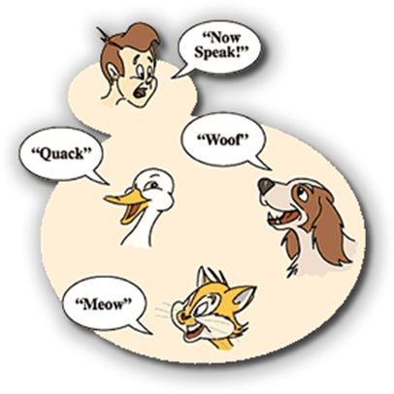
Abstraction
Live Demo

Slide 26
Interfaces
Object interfaces allow you to specify what methods a child class must implement
Declared with the interface keyword
Similar to abstract class
Interface can have only public methods
No method in an interface can have implementation
Interfaces are inherited with the implements keyword (instead of extends)
One class may implement multiple interfaces, if they do not have methods with same names

Slide 27
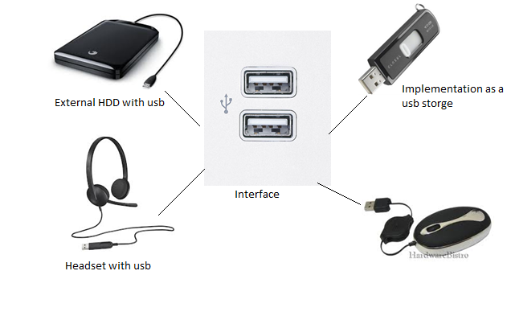
Interface
Live Demo

Slide 28

Overloading
Overloading in PHP provides the means to dynamically create members and methods via set of "magical" methods
Invoked with interacting with members or methods that have not been declared or are not visible in the current scope
All of the magic methods must be declared as public
None of the magic functions can be called with arguments, passed by reference

Slide 29
Overloading Methods
All overloading methods are invoked when accessing variable or method that is not declared or is inaccessible
__set($name, $value) – when writing
__get($name) – when reading
__isset($name) – when calling isset() function
__unset($name) – when calling unset() function

Slide 30
Overloading Methods
__call ($name, $arguments) - when calling a method
__callStatic ($name, $arguments) – when calling a method in a static context
Added after PHP 5.3
Must always be declared as static
PHP "overloading" is a lot different from most languages "overloading"
Usually it means the ability to declare two methods with different sets of parameters but same names

Slide 31
Object Iteration
PHP provides a way for object to be iterated trough as a list of items (array)
foreach can be used
By default iterates all visible properties

Slide 32
Overloading
Live Demo

Slide 33
Object Iteration
To take object iteration a step further, you can implement one of the PHP interfaces
Provided by the Standard PHP Library
Allows the objects to decide what to show and what not
Some provided interfaces:
Iterator – very long to implement but provides dull features
IteratorAggregate – simple version of Iterator interface
ArrayIterator, DirectoryIterator, etc.

Slide 34
Object Cloning
An object can be cloned with the clone keyword
This will create new independent object
Creating a copy of an object with fully replicated properties is not always the wanted behavior
$obj1 = new A();
$obj2 = clone $obj1;

Slide 35
Object Cloning
A class can implement the magic method __clone which is called for the newly created object
Called "clone constructor"
Allows necessary changes to be done on the newly created object
Example: Object holding reference to resource – the new object must have new references, instead of copies
Example: Object holding reference to another object that must not be copied

Slide 36

Cloning
Live Demo

Slide 37
Serializing Objects
Serializing is the process of transforming an object into a string, that can be stored
This string can be used to restore the object
Useful for storing objects in session data
Saves only properties values and class names – no methods
PHP provides the serialize and unserialize functions

Slide 38
Serializing Objects
serialize ($object) – returns string, representing the object
unserialize ($string) – returns new object, that is restored from the serialized string
unserialize requires the class to be defined before calling it

Slide 39

Serialization
Live Demo

Slide 40
Serializing Methods
Before serializing and after unserializing PHP checks if the class has the magic methods __sleep and __wakeup
__sleep allows the class to commit pending data, cleanup or define what needs to be stored if the object is very large
Should return array with names of properties to be stored
__wakeup allows the class to restore connections or other re-initialization

Slide 41
__sleep and __wakeup
class Connection {
protected $link;
private $server, $user, $pass, $db;
public function __construct($server, $user, $pass, $db) {
$this->server = $server;
$this->user = $user;
$this->pass = $pass;
$this->db = $db;
$this->connect(); }
private function connect () {
$this->link = mysql_connect (
$this->server, $this->user,
$this->pass);
mysql_select_db($this->db, $this->link); }
// continues on next slide

Slide 42
__sleep and __wakeup
// continues from previous slide
public function __sleep () {
// skip serializing $link
return array ('server', 'user',
'pass', 'db'); }
public function __wakeup () {
$this->connect(); }
}

Slide 43
Namespaces
Namespaces in PHP are designed to resolve scope problems in large PHP libraries
Simplify development in object oriented environment
Clears the code – no long classes names
In PHP all classes declarations are global
Namespaces allow to have two classes with same name
Old approach was adding prefixes to class names (Like the mysql_* functions)
Available since PHP 5.3

Slide 44
Namespace Definition
Namespaces are declared with the namespace keyword
Should be always in the beginning of the file
Namespace can contain classes, constants, functions but no free code
<?
namespace Project;
class MyTemplate { … }
function print_headers () { … }
…
?>

Slide 45
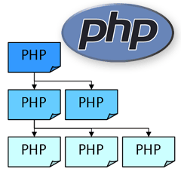
Namespaces
Classes, function and etc. in a namespace are automatically prefixed with the name of the namespace
So in the example we would use Project\MyTemplate to access the class
Constants in namespaces are defined with const keyword, not with define

Slide 46
Namespaces – Example
// file Project.php
namespace Project;
// declare base classes and etc.
…
// file project/db.php;
namespace Project\DB;
// declare DB interface for work with database
…
// file project/db/mysql.php
namespace Project\DB\MySQL;
// implement the DB interface for mysql
…
// somewhere in the project
require "project/db/mysql.php";
$a = new Project\DB\MySQL\Connection();
Project\DB\MySQL::connect();

Slide 47
Using Namespaces
The use operator allows aliasing namespaces names
If new name is not specified the namespace is imported in the current context (global namespace)
Even if aliased, every class and function can be accessed at any time by full name
use Project\DB\MySQL as DBLink;
$x = new DBLink::Connection();
DBLink::connect();
use Project\DB\MySQL;
$x = new MySQL::Connection();
MySQL::connect();

Slide 48
Global Namespace
By default PHP works in the global namespace
All the project is executed there
Method from the global namespace can be referred to with empty scope operator
namespace Project\Files;
// this is the Project\\Files::fopen function
function fopen (…) {
…
$f = ::fopen (…); // calls global fopen
… }

Slide 49
Autoloading Classes
Usually every class is declared in separate file
In big object oriented projects on every page you may have to include dozens of files
You can define __autoload function that is called when trying to access class that is not defined
It can include the necessary file for the class

Slide 50
Autoload Example
<?
function __autoload ($class_name) {
$name = "includes/".$class_name.".inc.php";
if (file_exists ($name))
include $name;
else
echo 'Class not found'; }
?>
Exceptions, thrown in __autoload cannot be caught and result in fatal error

Slide 51
Late Static Binding
PHP 5.3 introduces the late static binding which allows to reference the called class in context of static
In practice – this adds static:: scope
So if in the above example we use static::whoami() in the test() method body we get output 'B'

Slide 52


Summary
OOP reproduces objects from the real world
Serves for better code organization and data grouping
Namespaces are like packages for different groups of code
Prevent from code collision
PHP & MySQL

Slide 53
PHP & MySQL
https://softuni.bg/trainings/fasttracks/details/1033

Slide 54
License
This course (slides, examples, demos, videos, homework, etc.) is licensed under the "Creative Commons Attribution-NonCommercial-ShareAlike 4.0 International" license
Attribution: this work may contain portions from
"PHP Manual" by The PHP Group under CC-BY license
"PHP and MySQL Web Development" course by Telerik Academy under CC-BY-NC-SA license

Slide 55





Free Trainings @ Software University
Software University Foundation – softuni.org
Software University – High-Quality Education, Profession and Job for Software Developers
softuni.bg
Software University @ Facebook
facebook.com/SoftwareUniversity
Software University @ YouTube
youtube.com/SoftwareUniversity
Software University Forums – forum.softuni.bg

